Slide 1
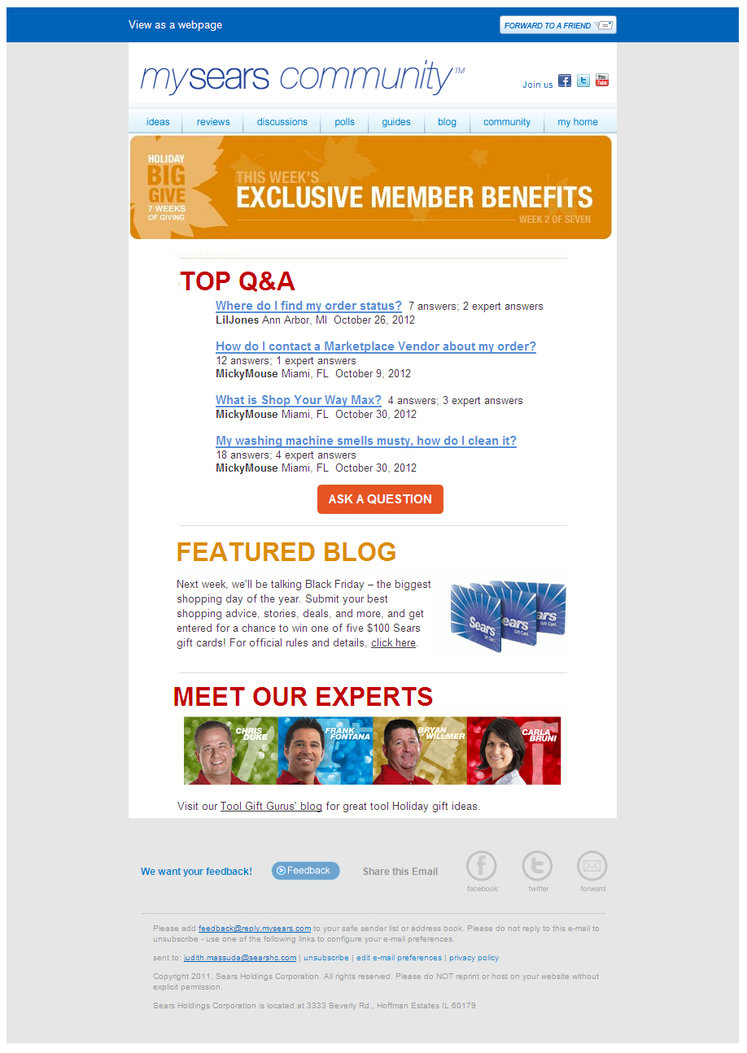


Welcome Trigger Email - FINAL (Mark-up)
Dynamic Field HERE- Screen name
Welcome to the MySears Community, lashondapink
For your records, here's your login info:
screen name: lashondapink email: lashondasimmons7@aol.com
Want to know the perfect TV for watching movies? Need help with your last order?
Just curious?
Then you’ve come to the right place.
Get new ideas from our blog posts , buying guides and categories.
Post your question and get an answer from the Community Team within 72 hrs.
Show off your big brain and answer other people’s questions.
Personalize your profile by adding a cool photo.
Whatever your question or issue, we’re here for you.
So welcome to the community. And don’t forget…it’s yours.
Have a question about the community? Visit our FAQs!
Sincerely, The MySears Community Team
Dynamic Field HERE- Screen name
Dynamic Field HERE- Email
Link goes to Blog page
Link goes to Buying guides page.
Link goes to Categories.
Link goes to Q&As page.
Link Upload Photo pop-up window with a file size limit.
Link goes to FAQs page.
mysears feedback link
SYWR link here
mysears email here
Basic email links
2012
Notes:
Welcome Email – triggered when a user joins the community > goes to the user who joined.

Slide 2
Welcome Trigger Email - FINAL (Clean)
Welcome to the MySears Community, lashondapink
For your records, here's your login info:
screen name: lashondapink email: lashondasimmons7@aol.com
Want to know the perfect TV for watching movies? Need help with your last order?
Just curious?
Then you’ve come to the right place.
Get new ideas from our blog posts , buying guides and categories.
Post your question and get an answer from the Community Team within 72 hrs.
Show off your big brain and answer other people’s questions.
Personalize your profile by adding a cool photo.
Whatever your question or issue, we’re here for you.
So welcome to the community. And don’t forget…it’s yours.
Have a question about the community? Visit our FAQs!
Sincerely, The MySears Community Team
2012
Notes:
Welcome Email – triggered when a user joins the community > goes to the user who joined.

